Slide 1
Applied Data Science and visualization 2024
Lecture 7 John Shorter

Slide 2
What did we learn last time?
We covered correlations and regressions, which is important if we are comparing numeric to numeric data
We covered proportions and enrichments. This is primarily used if we are comparing categorical data to other categorical data.

Slide 3
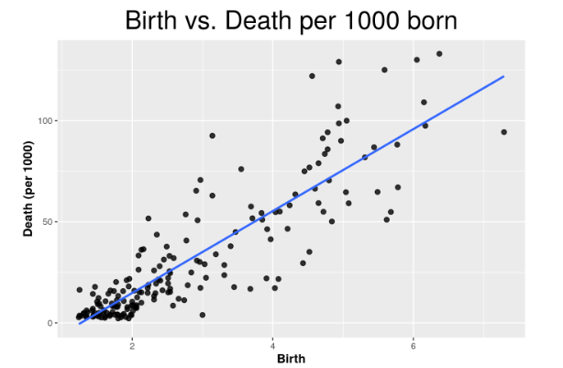
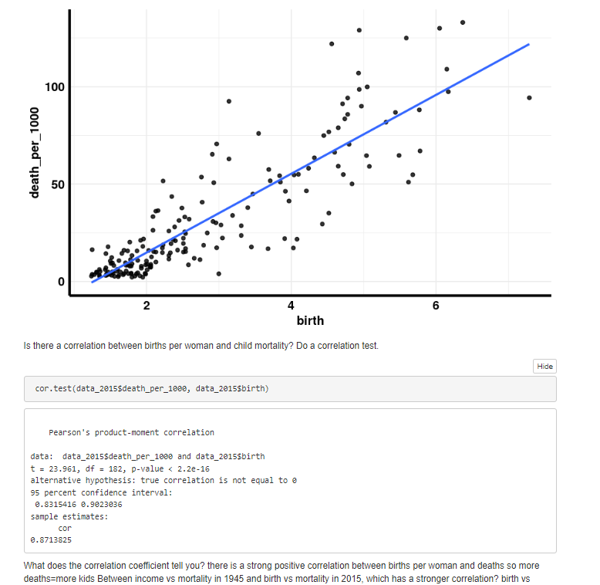
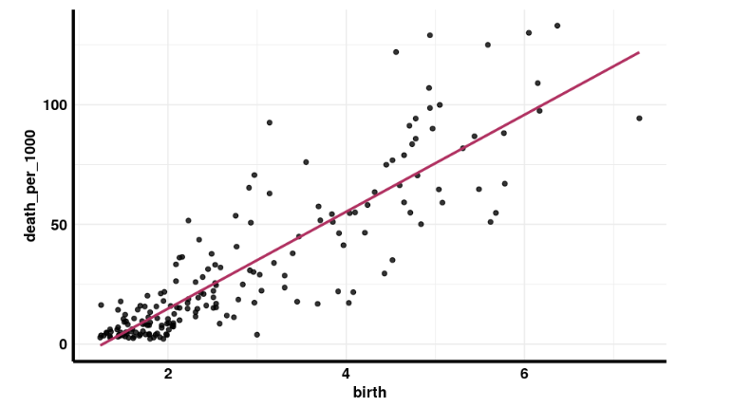
Nice examples from the homework
Visualize the relation between birth and child mortality across countries in year 2015

Slide 4
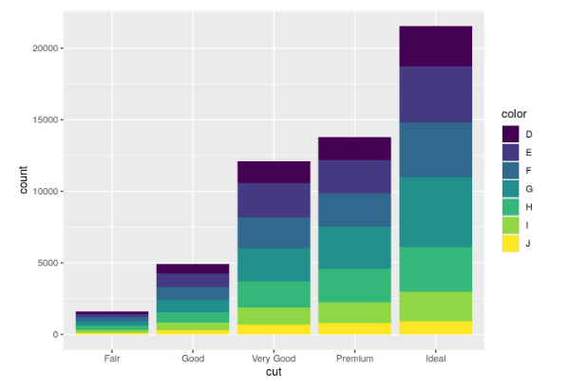
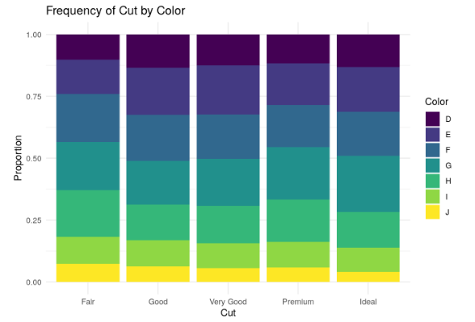
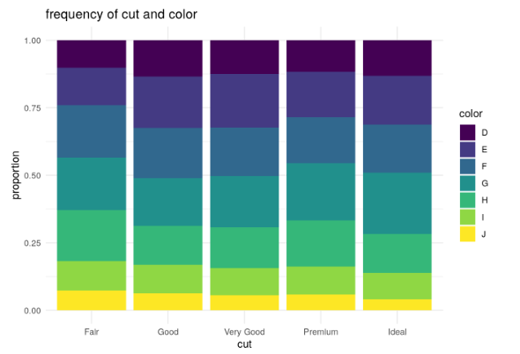
Nice examples from the homework

Slide 5
What are we going to do today?
We are going to discuss logistic regression. That is where an outcome is 0 or 1, or case and control.
Plus, a little more time for mini-project work.
We will also try a Ucloud free day. The exercise is on Moodle, so download the .Rmd document and open it on your local version of Rstudio.

Slide 6
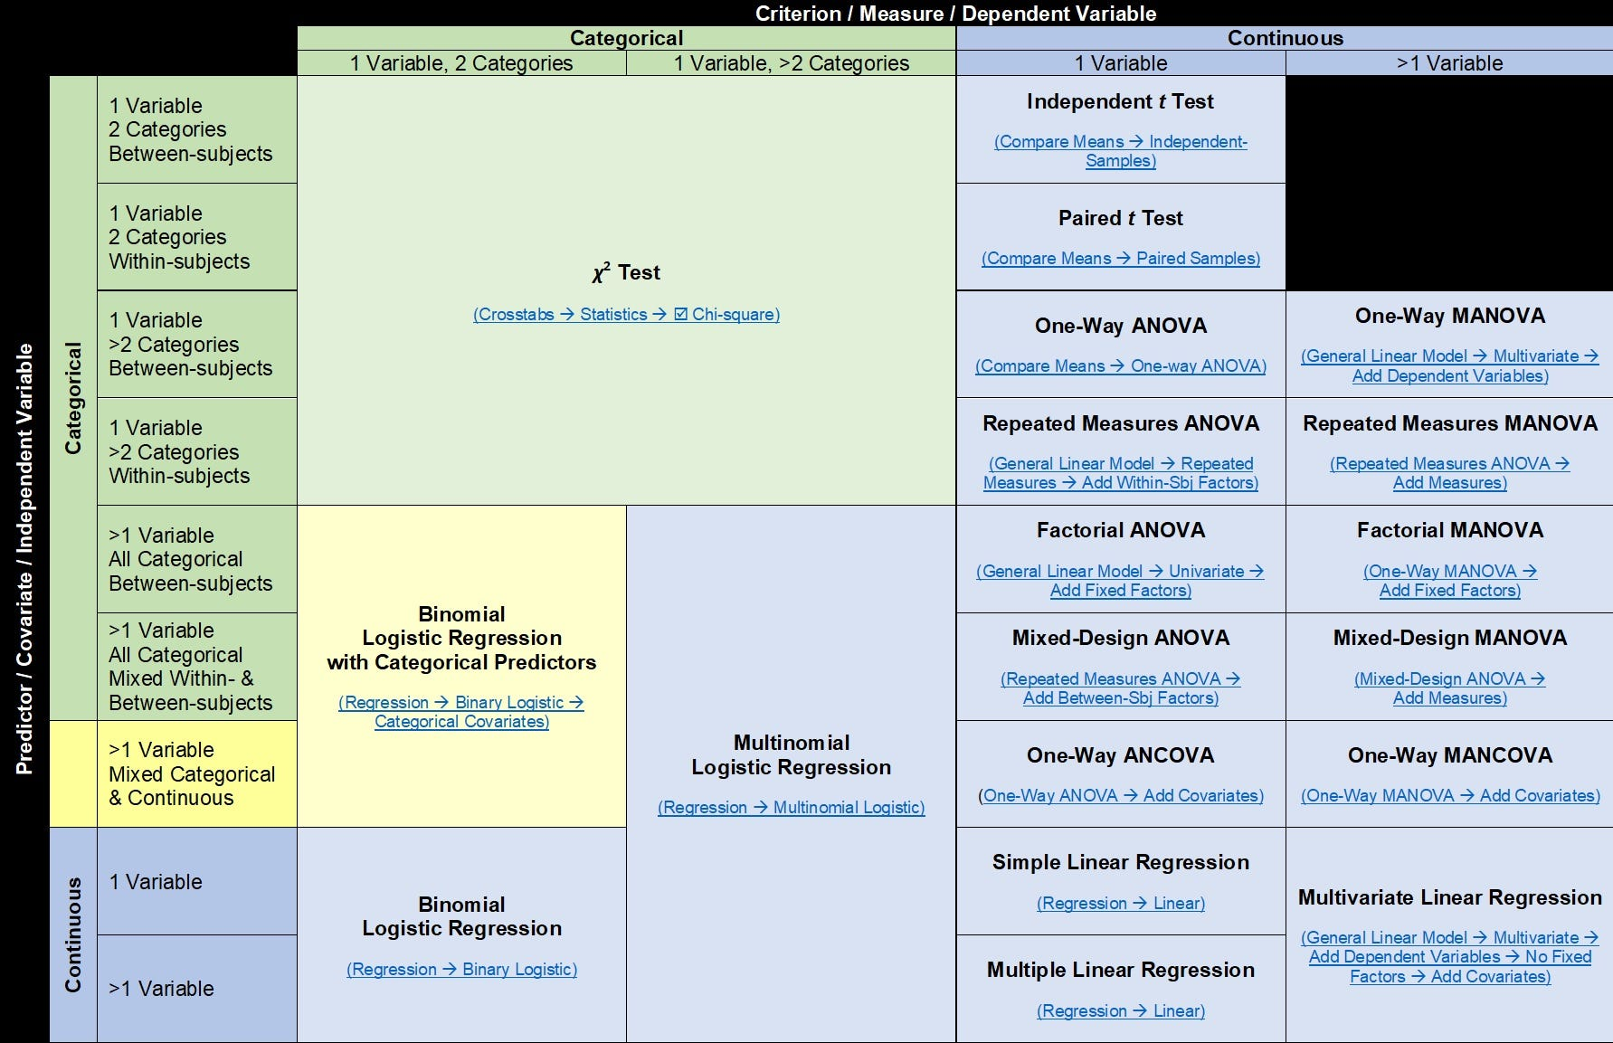

Slide 7
Let’s get started on RStudio

